Slide 1
Finding (and accessing) Remote Sensing Data
Ani Ghosh
anighosh@ucdavis.edu
Department of Environmental Science & Policy
Center for Spatial Sciences

Slide 2
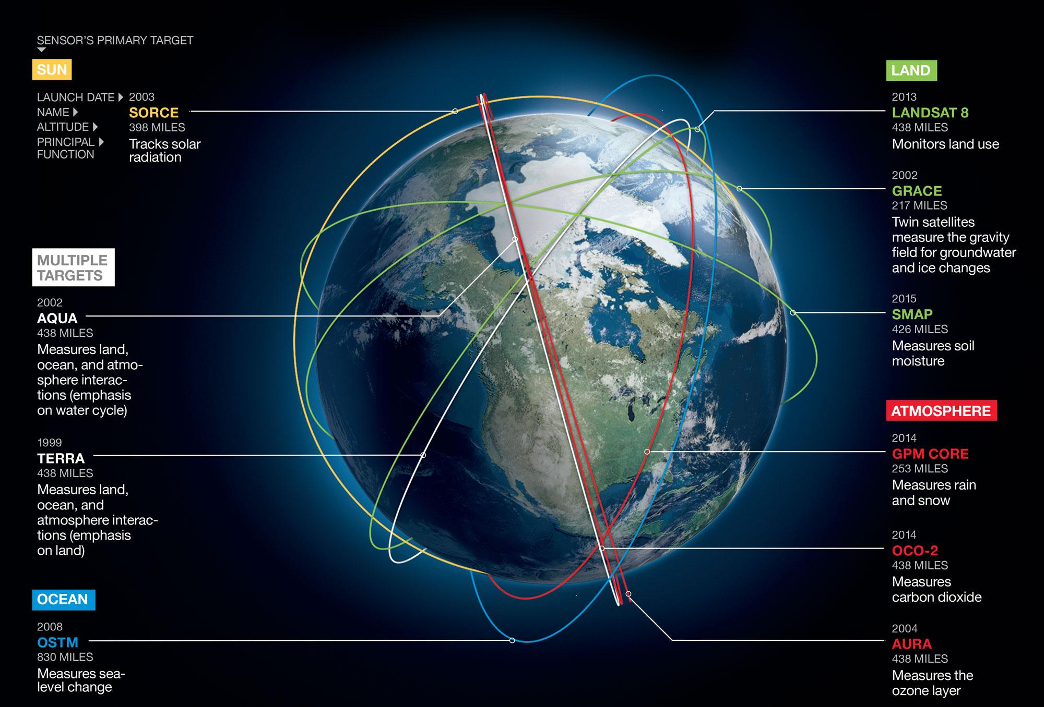
Remote Sensing Satellite in the Sky
The total size of all the satellite data so far collected is estimated over 100 Petabytes
https://www.gearthblog.com/blog/archives/2017/03/petabytes-of-imagery.html
Source: National Geographic

Slide 3
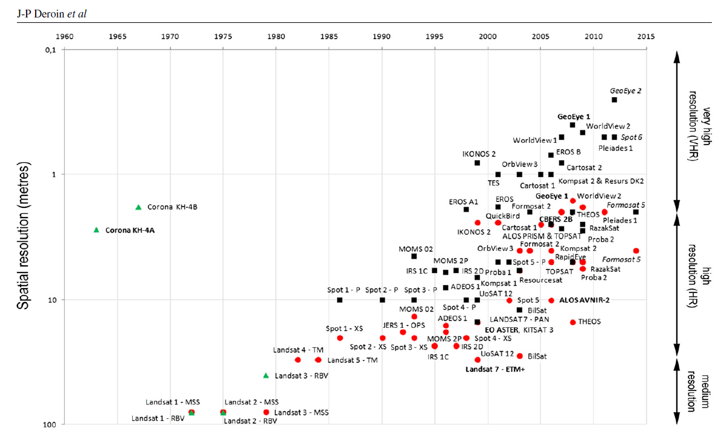
Earth Observation Satellite in the Sky
Black squares: panchromatic sensors.
Red dots:
multispectral sensors.
Green triangles: photographic process
Source: doi:10.1088/1742-2132/9/4/S40

Slide 4
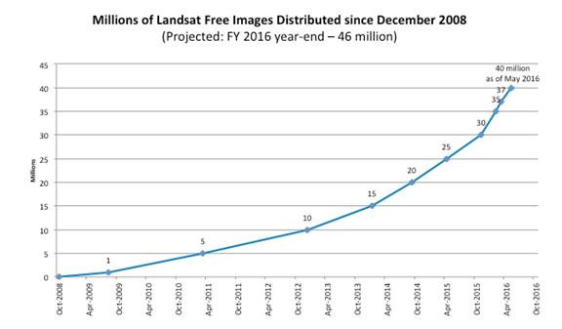
Impact of free data
The 2.38 million Landsat images freely downloaded in 2011, benefited the U.S. economy by $1.8 billion
Source: https://landsat.gsfc.nasa.gov/landsat-benefits-u-s-economy-by-1-8-billion-per-year/
http://www.asprs.org/a/publications/pers/2015journals/PERS_August_2015_Public/HTML/files/assets/basic-html/page49.html

Slide 5
What you need to know?
Do you need remote sensing data or product?
What kind of spatial details do you need?
Do you need historical information?
Do you need timely tasking for image acquisition?
Is your study area in a remote location?

Slide 6
What are the free data?
Most of the NASA and ESA data are free
Numerous data products

Slide 7
General Sources to search available data
USGS: https://eros.usgs.gov/find-data
USGS: https://lta.cr.usgs.gov/products_overview
WMO Space Programme: https://www.wmo-sat.info/product-access-guide/domain
Data Discovery Hub: http://data.satapps.org/
NOAA: https://www.nnvl.noaa.gov/view/globaldata.html

Slide 8
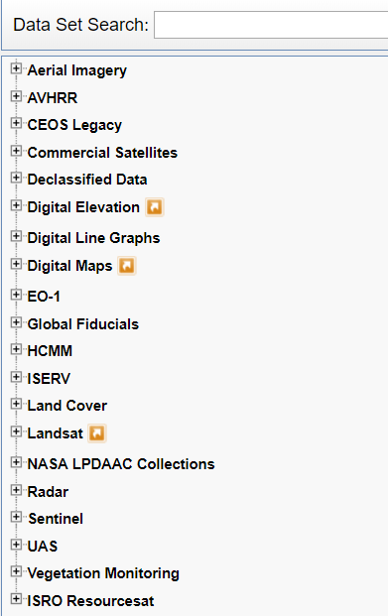
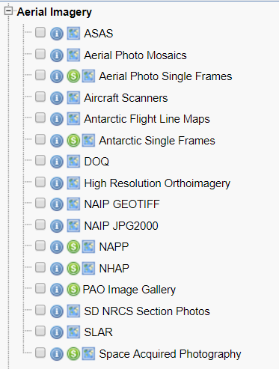
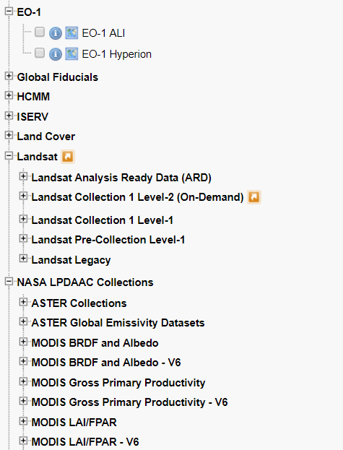
How to download NASA data?
https://earthexplorer.usgs.gov/

Slide 9
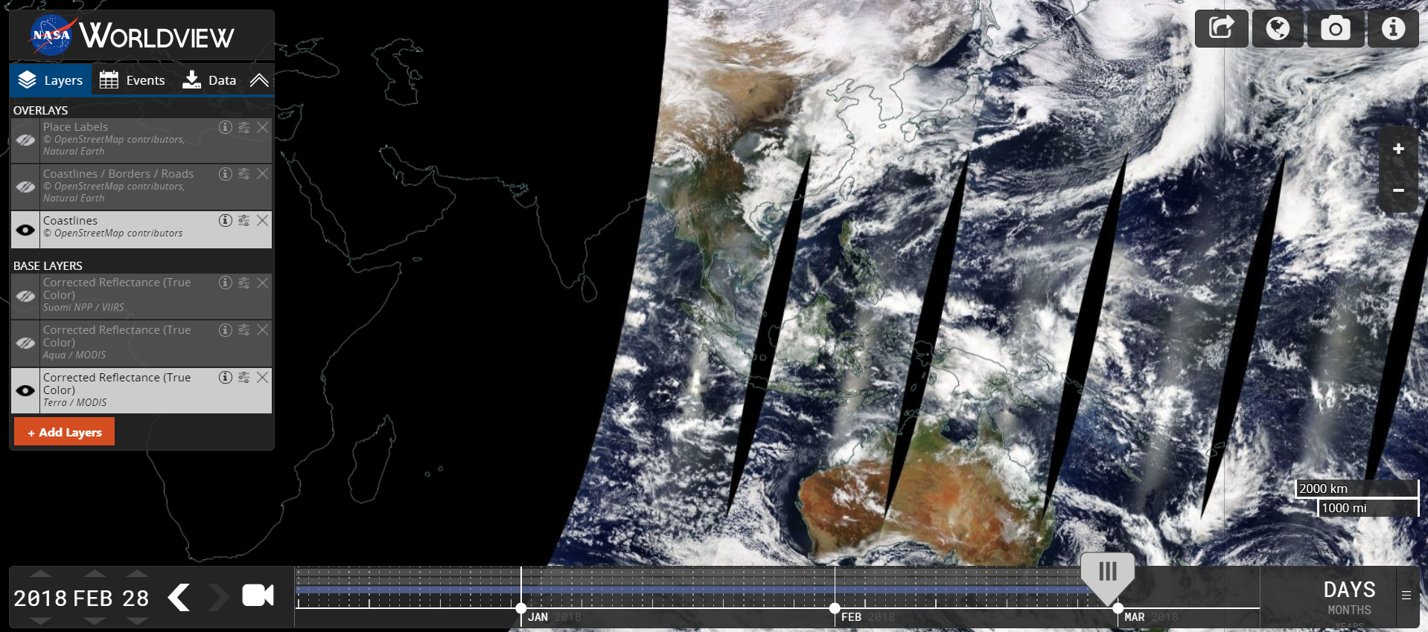
How to download NASA data?
https://worldview.earthdata.nasa.gov/

Slide 10
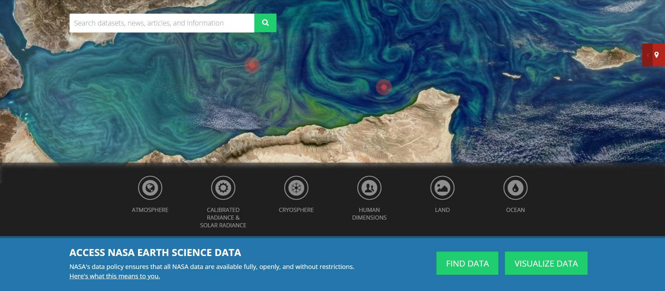
How to download NASA data?
https://earthdata.nasa.gov/
Great for quick visualization

Slide 11
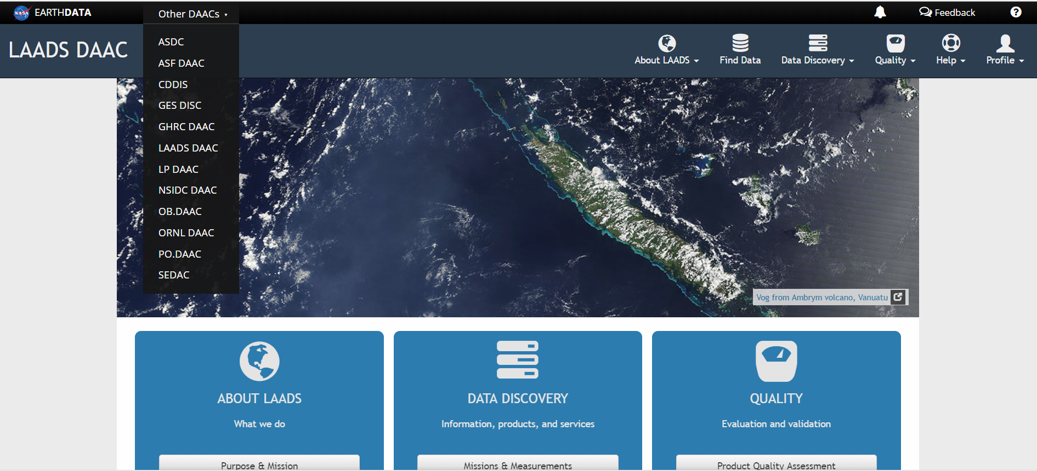
How to download NASA data?
https://ladsweb.modaps.eosdis.nasa.gov/

Slide 12
How to download NASA data?
You can use API (https://earthdata.nasa.gov/api)
R Packages: MODIS, MODISTools
Python packages

Slide 13
How to download ESA data?
Sentinel 1, 2 and 3: https://scihub.copernicus.eu/dhus/#/home
Python package: https://github.com/sentinel-hub/sentinelhub-py
API: https://sentinelsat.readthedocs.io/en/v0.9.1/api.html
QGIS: https://github.com/sentinelsat/sentinelsat-qgis-script

Slide 14
Google Earth Engine
Create account: https://developers.google.com/earth-engine/
Dataset available: https://earthengine.google.com/datasets/
And learn exporting the data https://developers.google.com/earth-engine/exporting
Can run scripts to process the data and do most of your work in the cloud

Slide 15
Other sources
ISRO:
http://bhuvan.nrsc.gov.in/data/download/index.php
JAXA: http://www.eorc.jaxa.jp/ALOS/en/dataset/dataset_index.htm

Slide 16
What about the ‘costly’ data?
Mostly the commercial satellites with high spatial resolution (5 meter or finer, even less than 50 cm)
SAR data like TerraSAR-X
LiDAR

Slide 17
Planet
Planet microsatellites (~120 cubesats with 3 and 4 bands)
RapidEye
Skysat (?)
Archive over 7+ Petabytes with 7+ Terabytes being added daily (March, 2017)

Slide 18
Getting Planet Data
https://www.planet.com/explorer/: Useful compare feature for visualization, monthly and 3-month composites
API access: https://www.planet.com/docs/reference/data-api/
Python client: https://www.planet.com/docs/api-quickstart-examples/cli/
Free data access:
https://www.planet.com/markets/education-and-research/
https://www.planet.com/products/open-california/

Slide 19
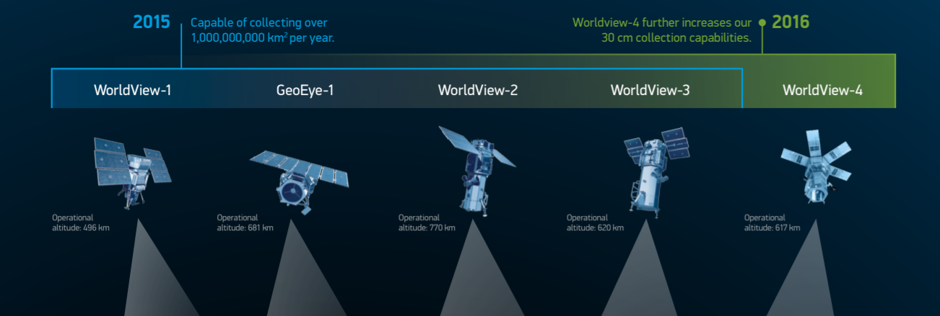
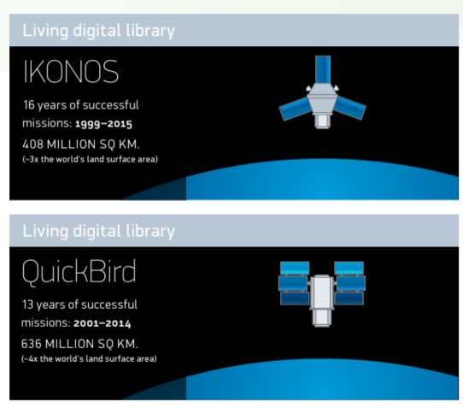
DigitalGlobe

Slide 20
Getting DigitalGlobe data
Search and discover: https://discover.digitalglobe.com/
Talk to us: https://spatial.ucdavis.edu/resources/data/
Or approach DigitalGlobe Foundation: http://foundation.digitalglobe.com/application/
Disaster Response: https://www.digitalglobe.com/opendata

Slide 21
Is your project funded by USG?
Talk to your Program Manager and ask about Next View (NV) license
E.g. for USAID funded project:
https://geocenterusaid.org/remotesensing/index.html
https://geocenterusaid.org/remotesensing/request.html

Slide 22
Work in progress...
Please reach me at anighosh@ucdavis.edu for suggestions, contributions

